Slide 1
PCBs
FROM SINGLE SIDED TO OVER 50 LAYERS
BESPOKE STOCK MANAGEMENT RELIABLE PARTNERSHIPS

Slide 2
ABOUT
GLOBAL LEADERS IN PCBs
Supply & Stock Management Specialists
Effective sourcing of Printed Circuit Boards (PCBs) requires commitment, time, and experience. Matching the technical and commercial requirements of clients to the capabilities of a manufacturing plant is a vital part of what we do.
We provide a total PCB Supply and Stock Management solution with over 50 years of PCB engineering, manufacturing, and logistics experience in our group. We can attribute our success to our expertise and commitment to quality.
To build on our enviable track record of growth and smart investment, we will continue to provide unrivalled ‘Excellence in Logistics’ to all our clients. In doing so, we will maintain our place as one of the leading forces in the PCB industry.
50 million customer PCBs supplied annually
W: www.es.tclelektronika.com
E: m.bach@tclelektronika.com
r.miras@tclelektronika.com
T: +34-671306818
+34-671306839

Slide 3
ABOUT
Daleba, GSPK & TCL Elektronika
A strong group of UK and European based companies
Tappenden & Co. Ltd
Local Fast-Turn & Prototyping
Far East & UK PCB Supply
Far East & EU PCB Supply
W: www.es.tclelektronika.com
E: m.bach@tclelektronika.com
r.miras@tclelektronika.com
T: +34-671306818
+34-671306839

Slide 4
ABOUT
1963 Daleba Electronics Ltd formed as a UK PCB manufacturer
1992 ISO9002 certification
1999 Hong Kong logistics facility opened
2001 QS 9000 certification UK
2007 DK Thermal created to focus on thermal PCB technology
2008 TCL acquires GSPK Circuits (Knaresborough)
1980 Acquired by TCL Group
1994 Far East PCB factory sourcing commenced
2000 China engineering & quality facility opened
2002 Thermal PCB production UK
2008 Daleba has 30 UK based staff & 25 in Hong Kong & China
2023 Daleba celebrates 60 years of trading
Daleba: AS9120B registration
DK Thermal & Daleba unmerge
2016 TCL Elektronika Kft. (Hungary) Incorporated April 2016
2013 Daleba celebrate 50 years of PCB manufacture and supply
2013 TCL acquires Evolution Circuits (Kettering)
2010 TCL acquires Kelan Circuits (Boroughbridge)
2024 GSPK celebrates
60 years of manufacturing.
2019 GSPK: AS9100D
registration
2014 Daleba/Evolution brand begins, for old Evolution Circuits customers
2013 TCL acquires Choice Interconnect.
2012 GSPK win the Queens award for enterprise
2009 TCL acquires Spemco (Ireland) and Printec (Arundel)
W: www.es.tclelektronika.com
E: m.bach@tclelektronika.com
r.miras@tclelektronika.com
T: +34-671306818
+34-671306839

Slide 5
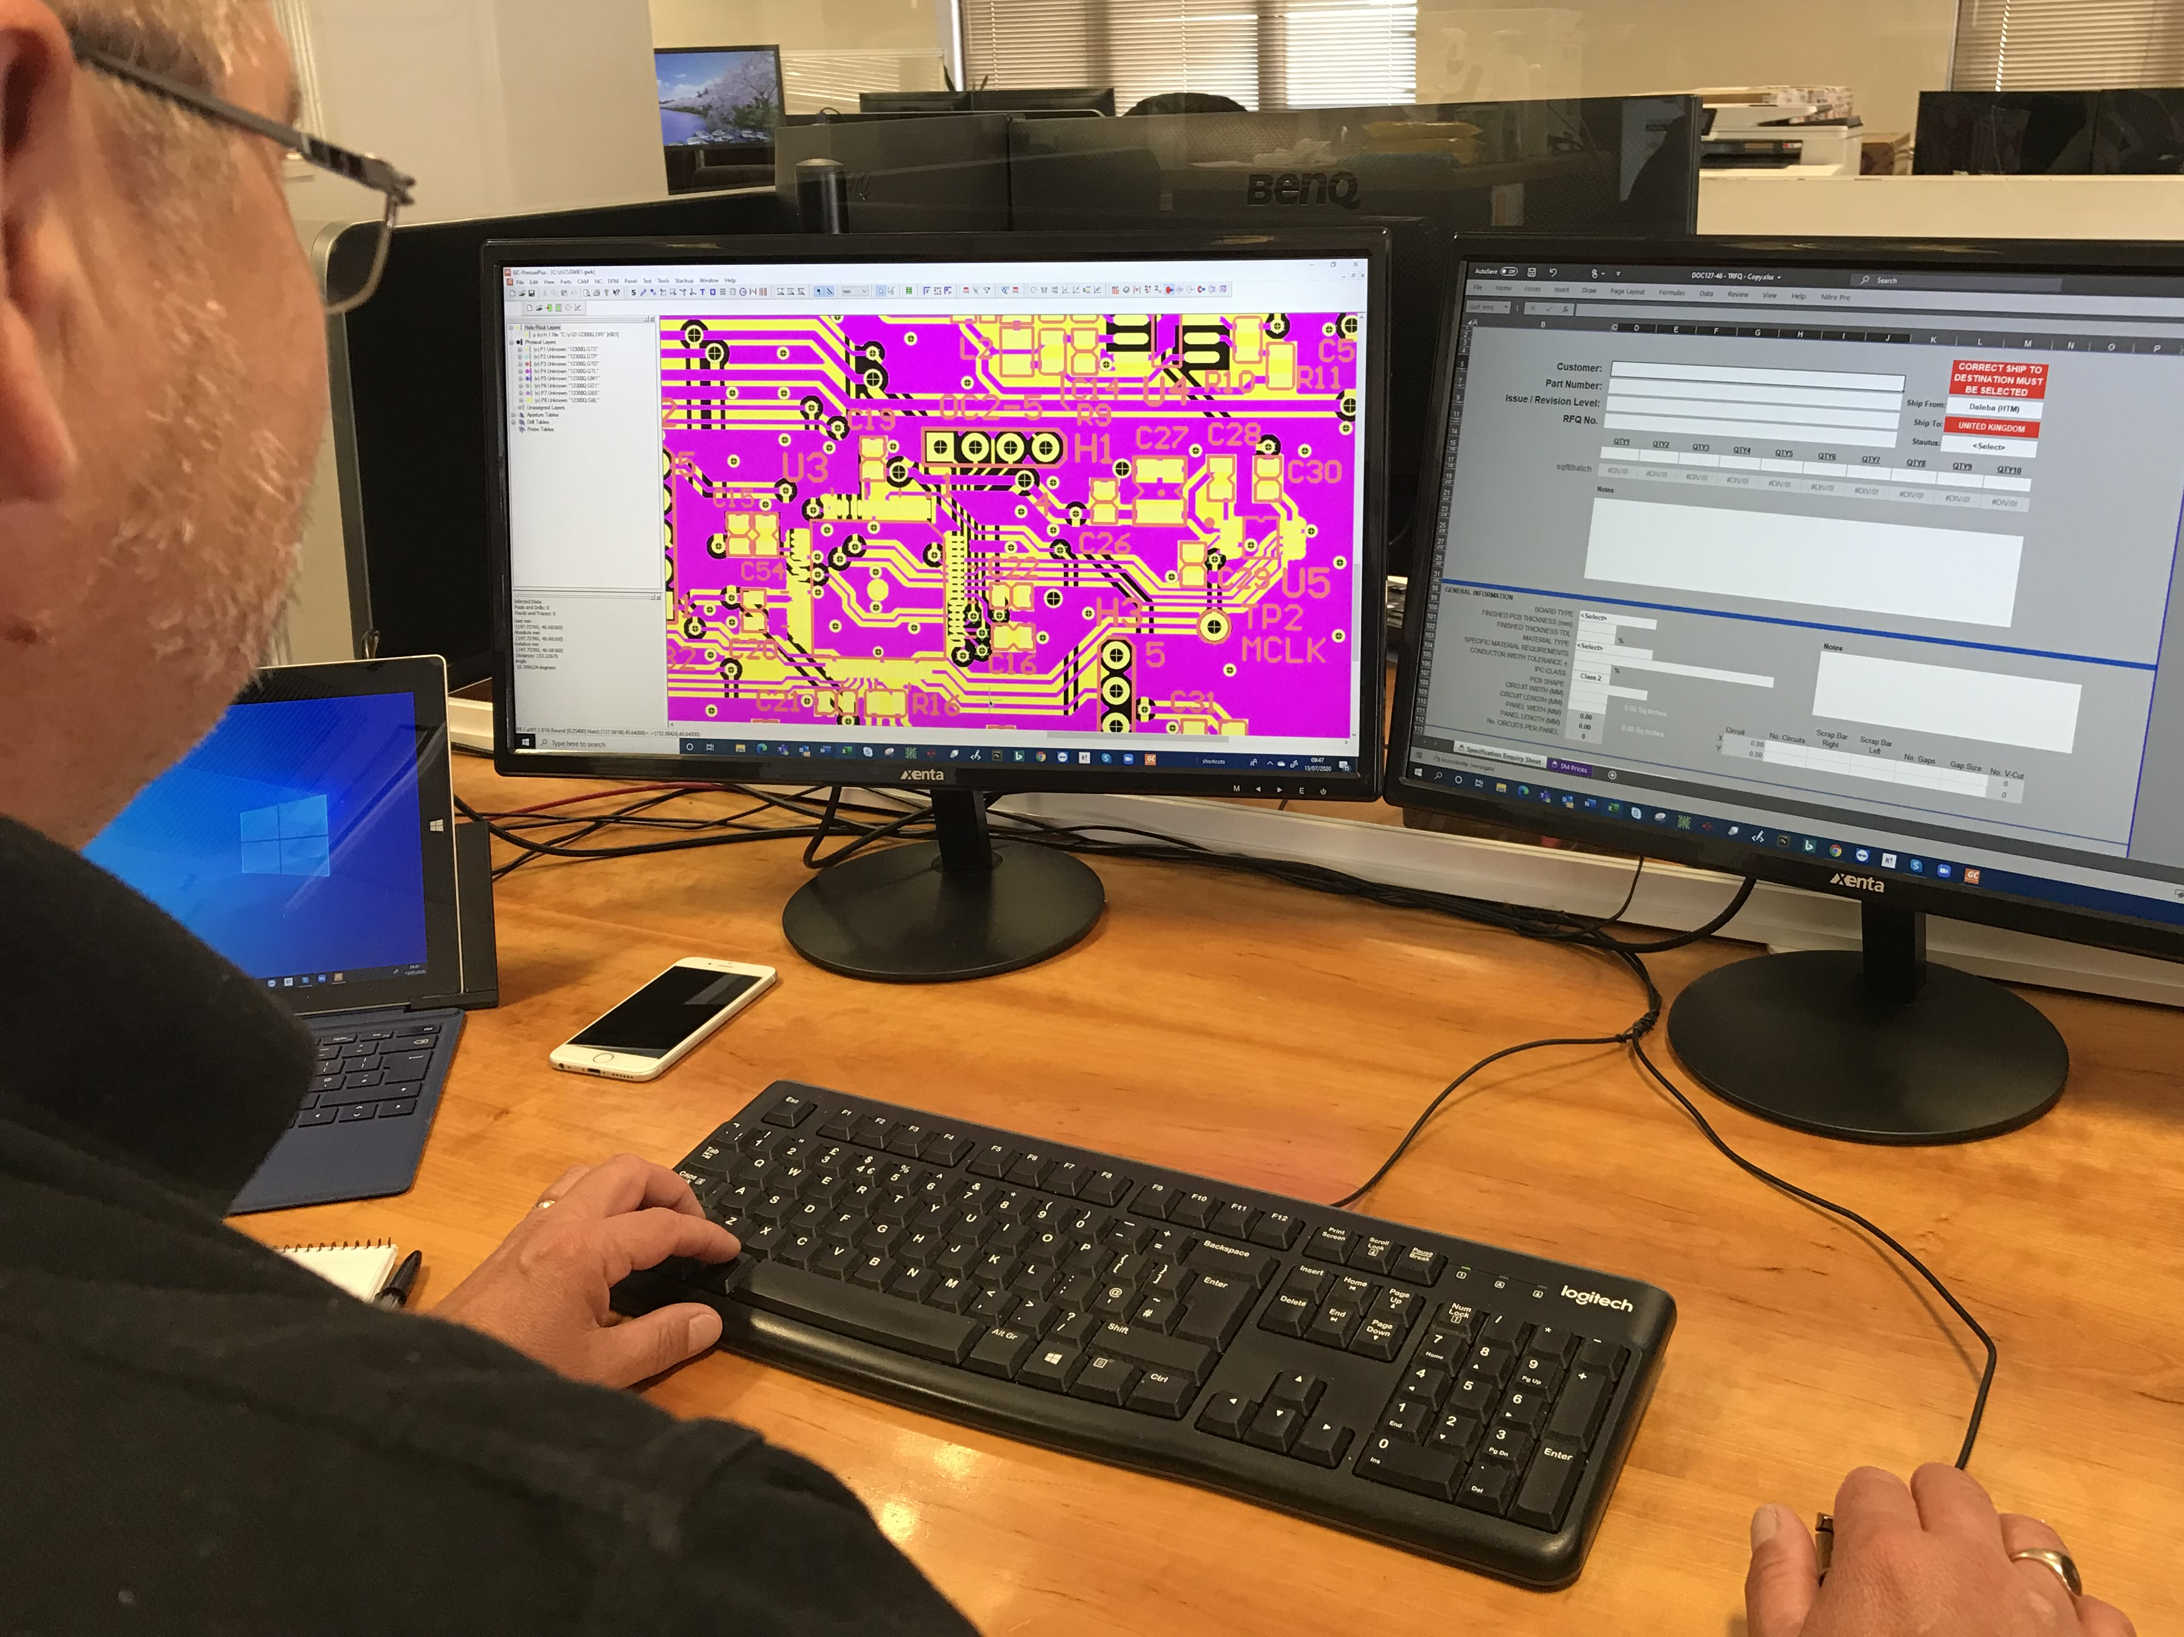
SERVICES
ENGINEERING
STOCK MANAGEMENT
GLOBAL LOGISTICS
Our dedicated engineers will focus on finding the best PCB solutions for your needs
Our engineering services include design for manufacture
We have UK and China Engineering Teams and all PCB Manufacturing Specification issued to partners
We perform full engineering reviews prior to production and individual specifications are issued for each PCB. Inspection reports received for each batch produced
Bespoke stock management is our speciality, which means we’ll find solutions for every requirement.
Our stock management team will monitor your usage against forecasted levels to ensure that production lines are kept running. This includes consignment stock, buffer stock, Kan Ban, JIT and ship to schedule.
Stress-free, on time, and without any of the headaches that logistics can cause: that’s how we deliver!
Our range of shipment options ensure you receive your order in the right place and at the right time, anywhere in the world.
W: www.es.tclelektronika.com
E: m.bach@tclelektronika.com
r.miras@tclelektronika.com
T: +34-671306818
+34-671306839

Slide 6
ADDING VALUE
Client cost benefits – without the cultural & communication challenges
Our own skilled Engineering & Quality staff in both Europe & Asia
In depth knowledge of Chinese PCB Fabrication partners (Capabilities/Approvals/Expertise)
“Best-fit” factory selection – multiple PCB Fab partners
Tried & tested logistics – local contact points, Heathrow, Stansted & London Gateway.
Quality underwritten
All PRC factory partners are subject to regular annual audits by our staff and our customers – supply-line transparency
UK factory for up to 16 layers
Dedicated to “Lean” manufacturing”
Fast turnaround of prototyping and mass production with IATF 16949, ISO 9001:2015, UL: E53704 (US & Canadian approvals)
Quality Assurance Dedicated UK and China QA Teams
ISO 9001:2015 Certification Factory IATF 16949 Certification
AS9100
W: www.es.tclelektronika.com
E: m.bach@tclelektronika.com
r.miras@tclelektronika.com
T: +34-671306818
+34-671306839

Slide 7
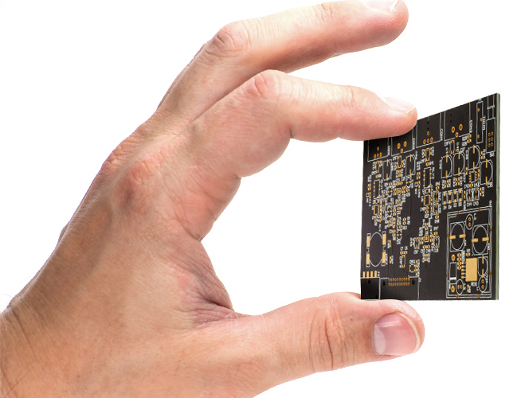
CAPABILITIES
UK, Europe or Far East Manufactured
We can produce IMS, Ceramic, Long Boards, Flex, Rigid-flex and Heavy Copper PCBS.
For your FR4 requirements, we can manufacture PCBs ranging from single-sided, to complex boards in excess of 50x layers.
In-house CAM engineering resources
Special requirements available such as: Selective gold plating for edge connectors, Peel-able solder resist, carbon pad printing
Globally available laminate materials: Shengyi, Kingboard, Iteq, Ventec, Nelco, Rogers, Isola and other RF/High Frequency materials
Full range of solder resist and ident colours to suit the application
UL certification for the technology and layer count available
All boards supplied 100% electrically tested
W: www.es.tclelektronika.com
E: m.bach@tclelektronika.com
r.miras@tclelektronika.com
T: +34-671306818
+34-671306839

Slide 8
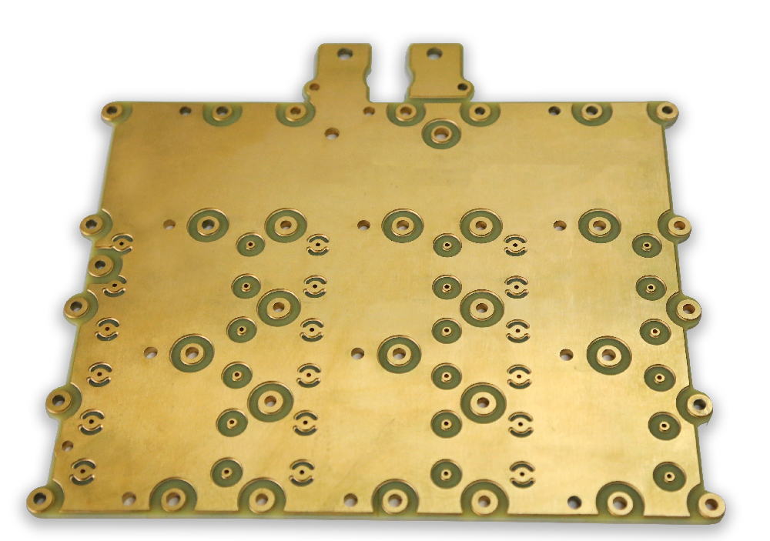
CAPABILITIES
Heavy Copper – High Power Applications
Heavy copper PCBs are printed circuit boards with 3oz or more of finished copper in the inner and/or outer layers
We also have the capability of Extreme Heavy Copper – up to 57oz (2mm) per layer for 2 layer applications
The construction of a heavy copper circuit give boards a number of benefits
Different copper thicknesses on outer layers with imbedded copper for one flat planar level.
Increased endurance to thermal strains
Increased current carrying capacity
1.00mm Copper Base Plate (28.5oz)
1x Prepreg type = EM8271 106
2.4mm Core H/H EM8271 (Etched off copper)
1 x Prepreg type = EM8271 106
1.00mm Copper Base Plate (28.5oz)
Increased mechanical strength at connector sites and in PTH holes
Reduced product size by incorporating multiple copper weights on the same layer of circuitry
W: www.es.tclelektronika.com
E: m.bach@tclelektronika.com
r.miras@tclelektronika.com
T: +34-671306818
+34-671306839

Slide 9
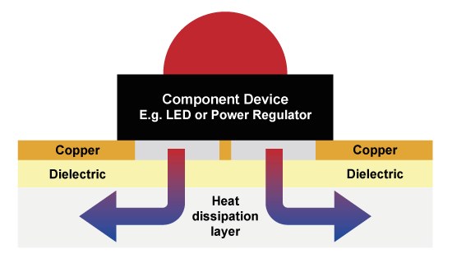
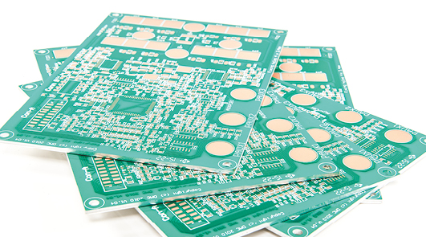
CAPABILITIES
Metal Clad PCBs – Thermally Conductive
Efficient heat transfer from component to heat sink.
Aluminium or Copper based substrates with an electrically insulating, thermally conductive dielectric layer.
Thermal Conductivity options ranging from 1W/mK to 9W/mK
A range of material options: Ventec, Denka, Bergquist, Laird, Doosan etc.
Applications include: Automotive lighting and power, street lighting, hazardous area lighting, LED luminaires, high power.
Long boards capability – up to 1.5m in length
W: www.es.tclelektronika.com
E: m.bach@tclelektronika.com
r.miras@tclelektronika.com
T: +34-671306818
+34-671306839

Slide 10
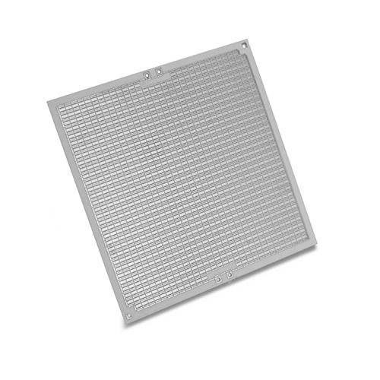
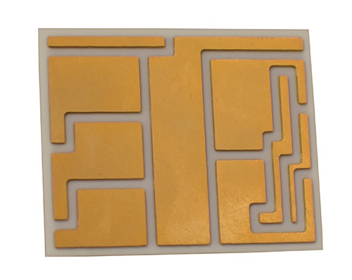
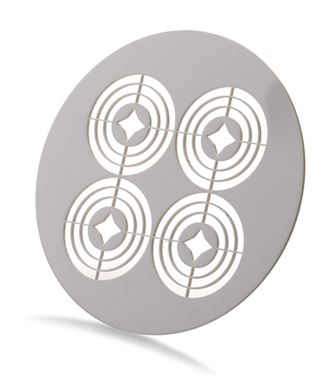
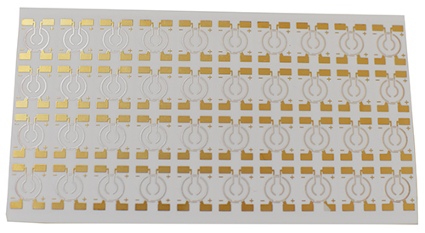
CAPABILITIES
Ceramic PCBs
Superior heat dissipation is the key advantage that Ceramic has over more conventional materials used for PCB production.
Superior values of Thermal Conductivity (up to 180W/m-K)
High operating temperatures over 350ºC
Very Low CTE (Coefficient of Thermal Expansion)
Suitable for high frequency applications due to low signal loss
Possibility for Hermetic packages with 0% water absorption
Alumina Oxide (Al2O3), AlN (Aluminium Nitride) and SiN (Silicon Nitride) options available
DPC (Direct plated copper) & DBC (Direct bonded copper) used for circuitry
W: www.es.tclelektronika.com
E: m.bach@tclelektronika.com
r.miras@tclelektronika.com
T: +34-671306818
+34-671306839

Slide 11
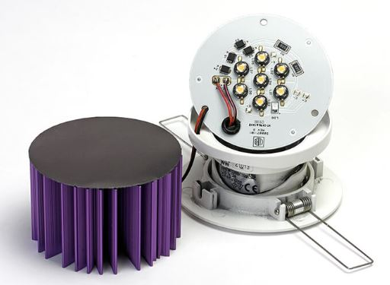
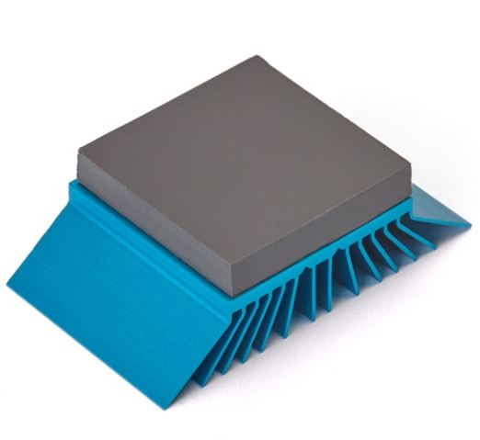
CAPABILITIES
EMI Thermal – Material Distribution and Conversion
THERMAL INTERFACE MATERIALS
Electronic components being driven harder, running at higher power
This causes heat which can result in overheating, damage and failure.
Thermal Interface Material (TIM) helps manage this issue
Air is a poor conductor of heat, so air gaps need to be removed.
TIM, a thermally conductive medium is used to fill the air gap between mating surfaces in electronic components.
With no air gap the heat is transferred between the component and its heatsink or chassis.
W: www.es.tclelektronika.com
E: m.bach@tclelektronika.com
r.miras@tclelektronika.com
T: +34-671306818
+34-671306839

Slide 12
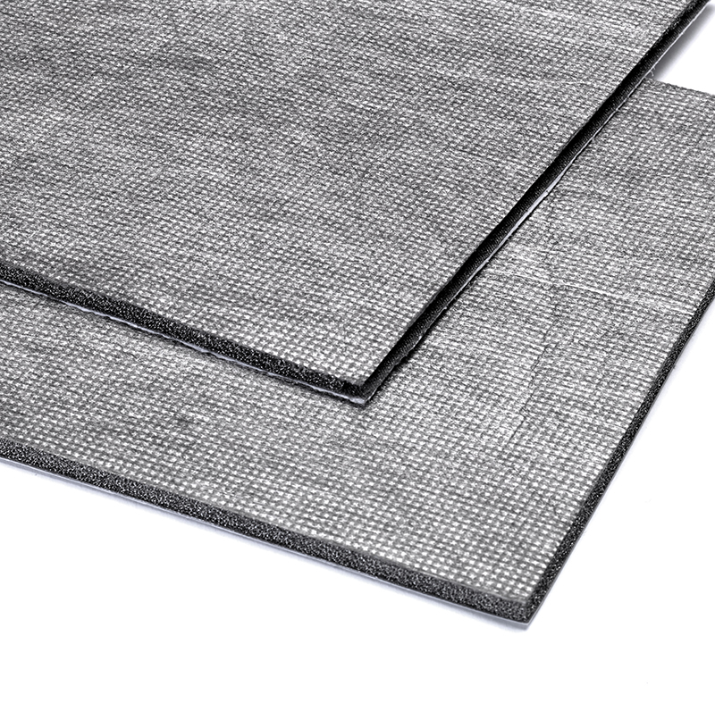
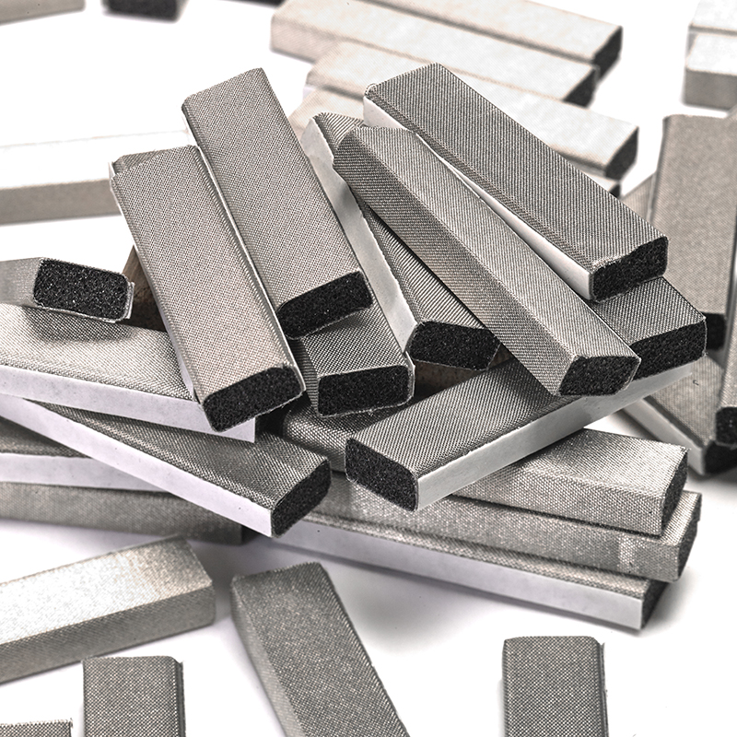
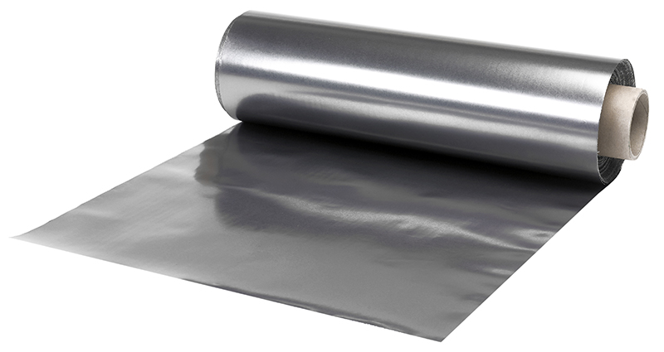
CAPABILITIES
EMI Thermal – Material Distribution and Conversion
EMI/EMC/RFI MATERIALS
Electromagnetic Compatibility (EMC) is a vital part of any new component design
The unit must operate without emitting or being susceptible to electromagnetic waves
The drive for higher integration, smaller electronics devices and fast speeds, problems with both Electromagnetic interference (EMI) and Radio Frequency Interference (RFI) continue to increase
To help you manage this we have a range of shielding products to confine emissions to a certain area within the unit
This shielding is also used to stop external emissions or signals penetrating and corrupting the electronics from outside
W: www.es.tclelektronika.com
E: m.bach@tclelektronika.com
r.miras@tclelektronika.com
T: +34-671306818
+34-671306839

Slide 13
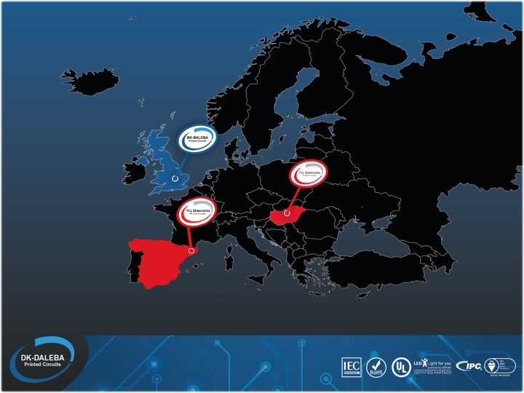
EUROPEAN LOCATIONS
Our offices In Barcelona, Spain and Budapest, Hungary are taking care of our European customers since 2008.
HERTFORD
BUDAPEST
SPAIN
W: www.es.tclelektronika.com
E: m.bach@tclelektronika.com
r.miras@tclelektronika.com
T: +34-671306818
+34-671306839

Slide 14
SUMMARY
UK, Europe & Far East supply capability
Single sided through hole, multilayer & flexi/flexi-rigid
Complete thermal management solutions
Prototyping UK, Europe and Far East
DFM
Metal Circuit Boards
Tried & tested inventory management models
Ceramic Circuits
Proven Logistics
Local, highly experienced, account management & support
European group offices in Spain, Hungary and Ireland
Global track record for delivering excellence
W: www.es.tclelektronika.com
E: m.bach@tclelektronika.com
r.miras@tclelektronika.com
T: +34-671306818
+34-671306839

Slide 15
Thank you for your time today!

